Slide 1

The Egyptian E-Learning University Faculty Of Computers And Information Technology Department Of Information Technology Final Year Project Telemedicine Cloud Application Using Homomorphic Encoding
Authors: Omar Nabih Ali 20-01252 Kareem Saeed Mohamed 20-00808 Hazem Medhat Kamel 20-01032 Fouad Mohamed Fouad Taha 20-00656 Youssef Yasser 20-01350 Hatem Rabeeh Aboelftooh 1900186
Supervisors: Prof. Dr. Islam Alkabbany Eng. Mohamed Saeed

Slide 2


Slide 3
Outlines
What is Telemedicine cloud Application? Type of cloud model What Is Encryption ? How It Works? What is Homomorphic? What is Homomorphic Encryption? How It Works? Type of Homomorphic Encryption works of PHE and FHE Applications Conclusion

Slide 4
What is Telemedicine cloud Application?
• Telemedicine cloud provides us a means by which we can access the applications as utilities, over the Internet. • With Telemedicine cloud users can access database resources via the internet from anywhere for as long as they need without worrying about any maintenance or management of actual resources.

Slide 5


Slide 6
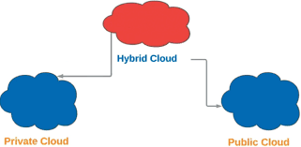
Type Of Cloud Model

Slide 7
Cloud Model
Private Cloud • Operated solely for an organization • Managed by the organization or a third party • Retains high degree of control, privacy and security Public Cloud • Managed by owned and service provider • Made available to the general public or a large industry group Hybrid Cloud • Composition of two or more clouds (private or public) bound together by standardized or proprietary technology that enables data and application portability

Slide 8
What Is Encryption ?
• Encryption Is encoding messages or information with a key in such a way that only authorized parties can read it. • Used to protect data in transit.

Slide 9
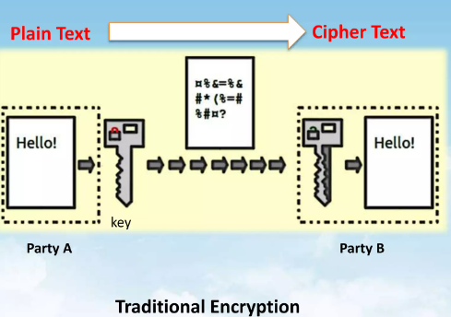
How It Works?

Slide 10
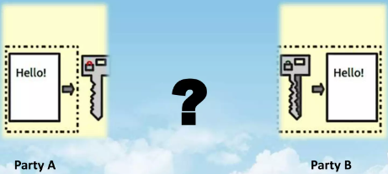
Problem With Traditional Encryption?
What If Party A does not trusts Party B, with its confidential data.

Slide 11
Homomorphic
• Homomorphic (Mathematical Term) describes the transformation of one data set into another while preserving relationships between elements in both sets. • Homomorphic is a Greek word for "same structure"

Slide 12
Homomorphic Encryption
• Definition: A crypto-system that allows another party to perform operations on cipher text (Encrypted Text) without having knowledge of your secret key/Password. • So if X1 and X2 are two numbers, E(X1) and E(X2) represents the encryption of these numbers with a secret key, another party would be able to compute E(X1 + X2) or E(X1 * X2) without knowing the secret key.

Slide 13
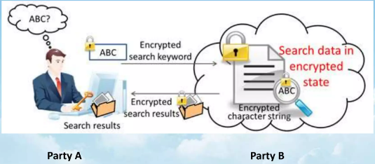
Homomorphic Encryption
Party B does NOT requires the secret key for answering this query from A

Slide 14
Type of Homomorphic Encryption
1. PHE (Partially Homomorphic Encryption):
• When You can only perform certain mathematical operations on the cipher text but not others. - Caesar Cipher is Partially Homomorphic With respect to addition. - RSA Cryptosystem is Partially Homomorphic with respect to Multiplication. 2.FHE (Fully Homomorphic Encryption):
• FHE support the homomorphic property for all the mathematical operations you can think of + - / * % & || ^.

Slide 15
How It Works !
• Suppose I have a file with my phone number Message = [9, 0, 2, 6, 7, 2, 8, 1, 6, 8] • And I encrypt it with Caesar cipher* by adding 2 to each digit, Key = 2 Cipher = [11, 2, 4, 8, 9, 4, 10, 3, 8, 10] • Want to find the sum of all the numbers in Message • Sum up all the elements of Cipher and give the encrypted result. Summation(Cipher) = 69 • Summation(Message) = 49 • Remove Encryption on Summation(Cipher) = 69- 10*2 • = 49 (Result)

Slide 16
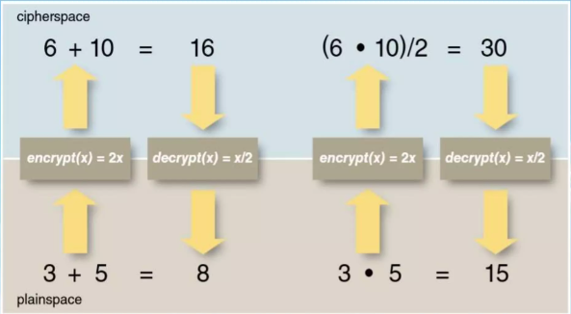
How It Works !
A rudimentary Homomorphic cryptosystem

Slide 17
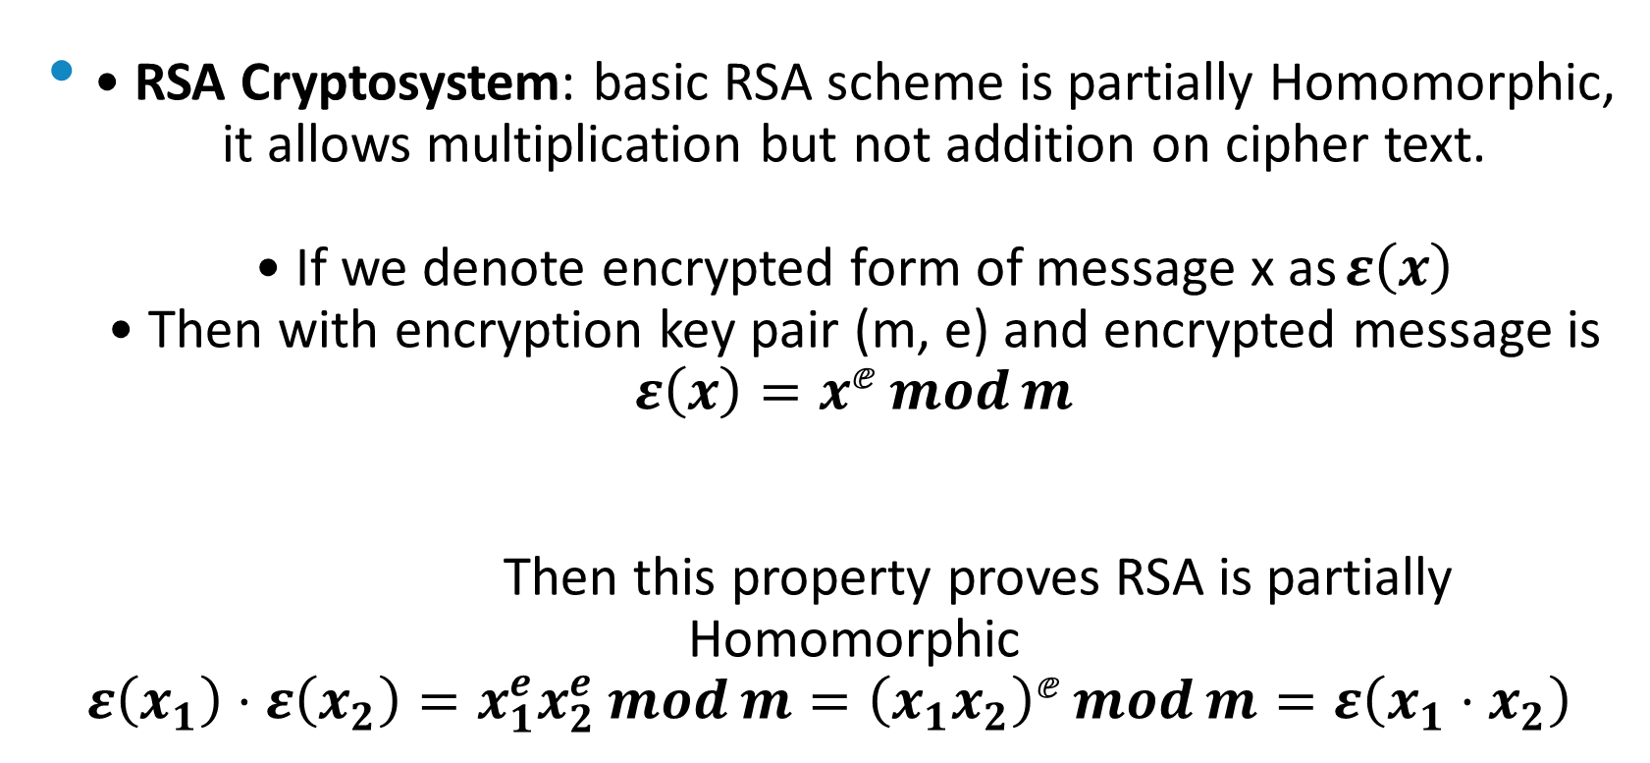
How It Works !
• RSA Cryptosystem: basic RSA scheme is partially Homomorphic, it allows multiplication but not addition on cipher text. • If we denote encrypted form of message x as $ε\left(x\right)$ • Then with encryption key pair (m, e) and encrypted message is $ε\left(x\right)=x^{ⅇ}\operatorname{mod}{m}$ Then this property proves RSA is partially Homomorphic $ε\left(x_{1}\right)⋅ε\left(x_{2}\right)=x_{1}^{e}x_{2}^{e}\operatorname{mod}{m}={\left(x_{1}x_{2}\right)}^{ⅇ}\operatorname{mod}{m}=ε\left(x_{1}⋅x_{2}\right)$

Slide 18
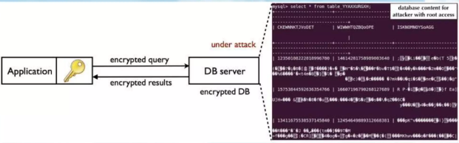
Applications
Online vote system Everyday Usage Data Encrypted Query Processing

Slide 19
Conclusion
We demonstrated in this article a functioning architecture of a web service that uses homomorphic encryption to carry out private intelligent detection activities on protected health information. The web host allows forecasts despite only processing authenticated data and knowing little about the sent sensitive patient data. The data can be encrypted and stored in the cloud using an optimized homomorphic encryption algorithm. Cloud services provide extensive computational resources for secure.

Slide 20
References
• http://www.iaeng.org/publication/WCE2012/WCE2012 pp53 6-539.pdf • https://arxiv.org/ftp/arxiv/papers/1409/1409.0829.pdf http://www.slideshare.net/iamrandomizer/homomorphic- encryption-53238006 • https://en.wikipedia.org/wiki/Homomorphicencryption

Slide 21
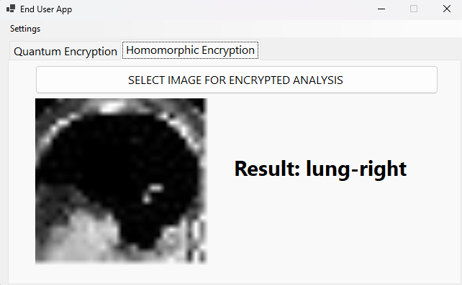
Client Side View

Slide 22
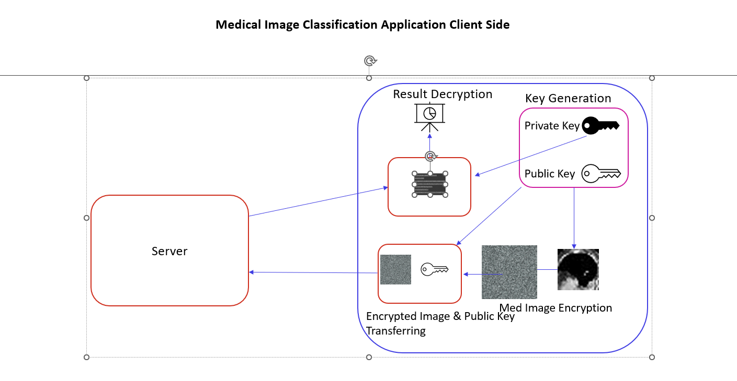
Client Side

Slide 23
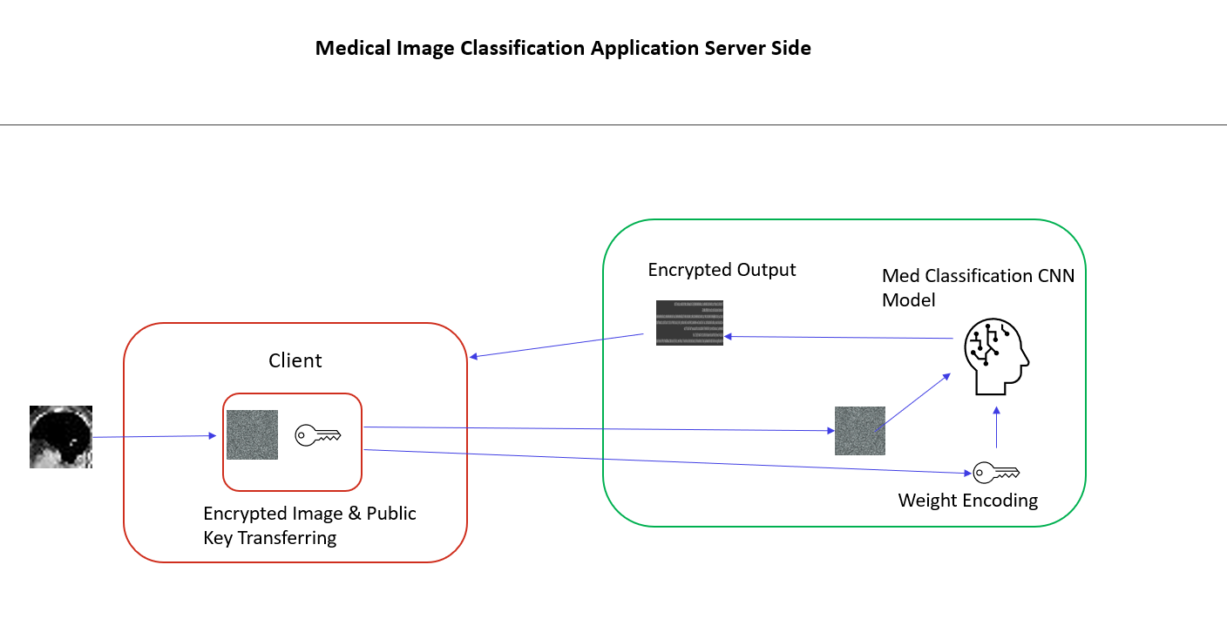
Server Side

Slide 24


Slide 26
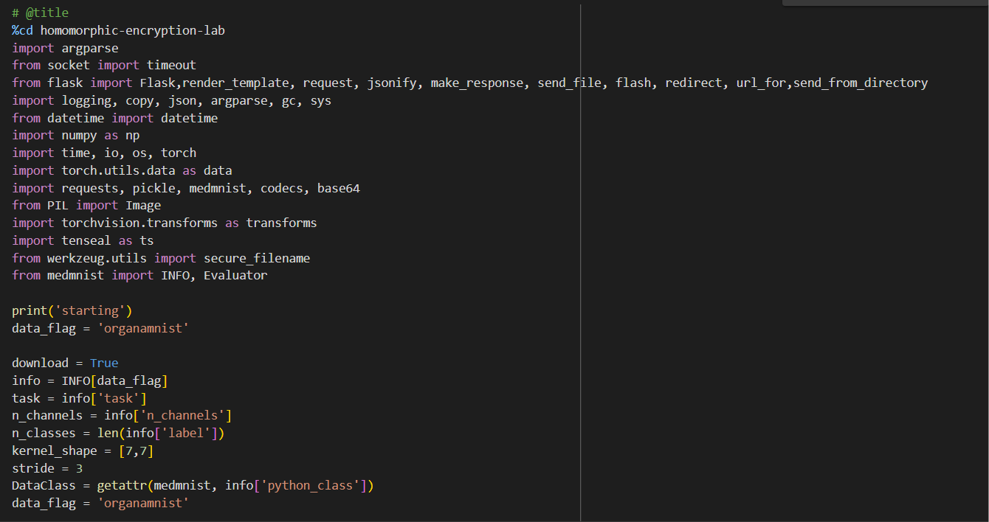

Slide 27
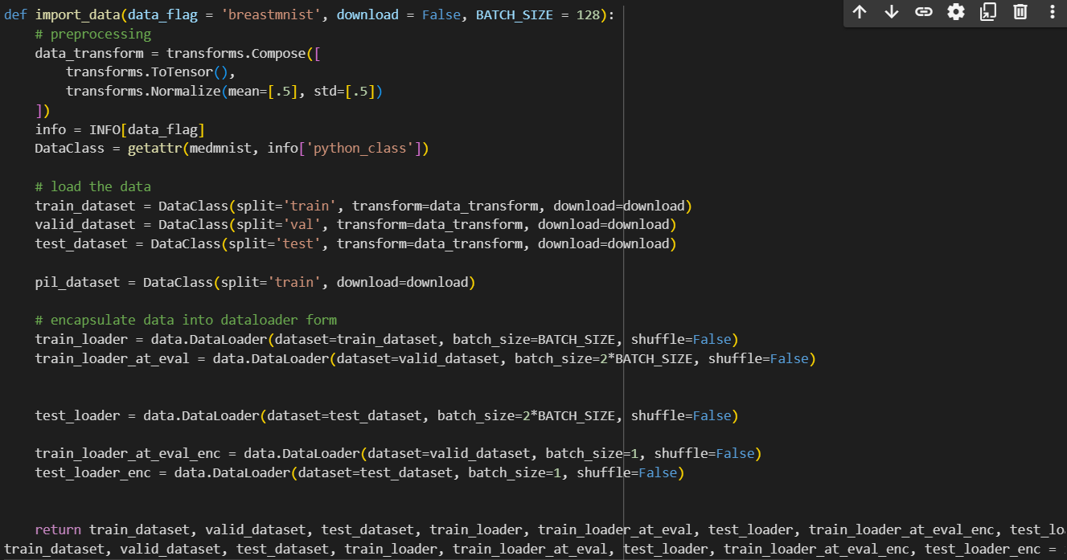

Slide 29
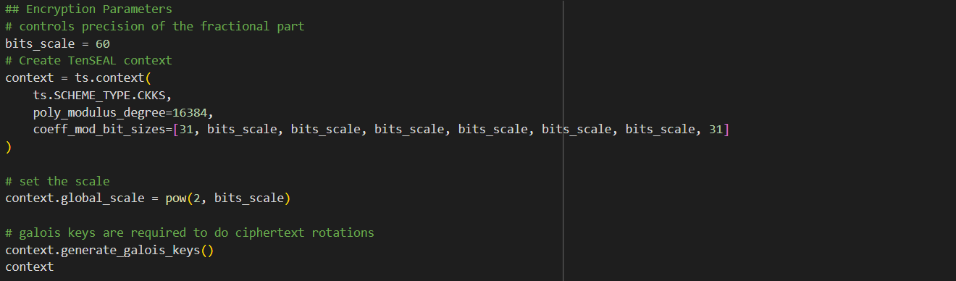

Slide 31


Slide 33


Slide 73


Slide 74
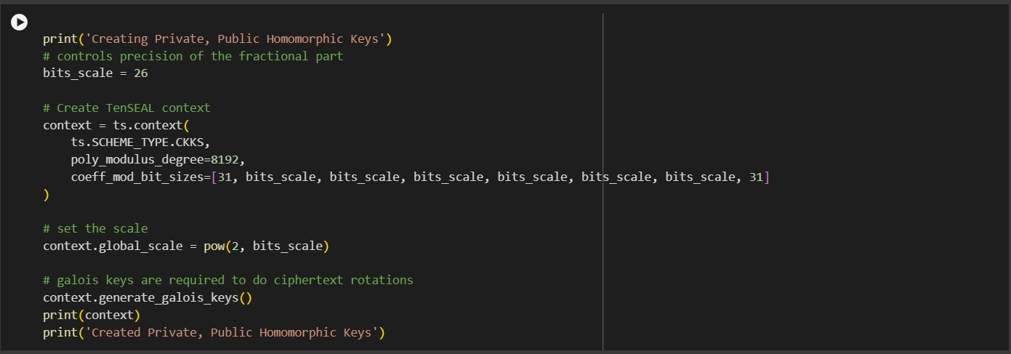

Slide 75
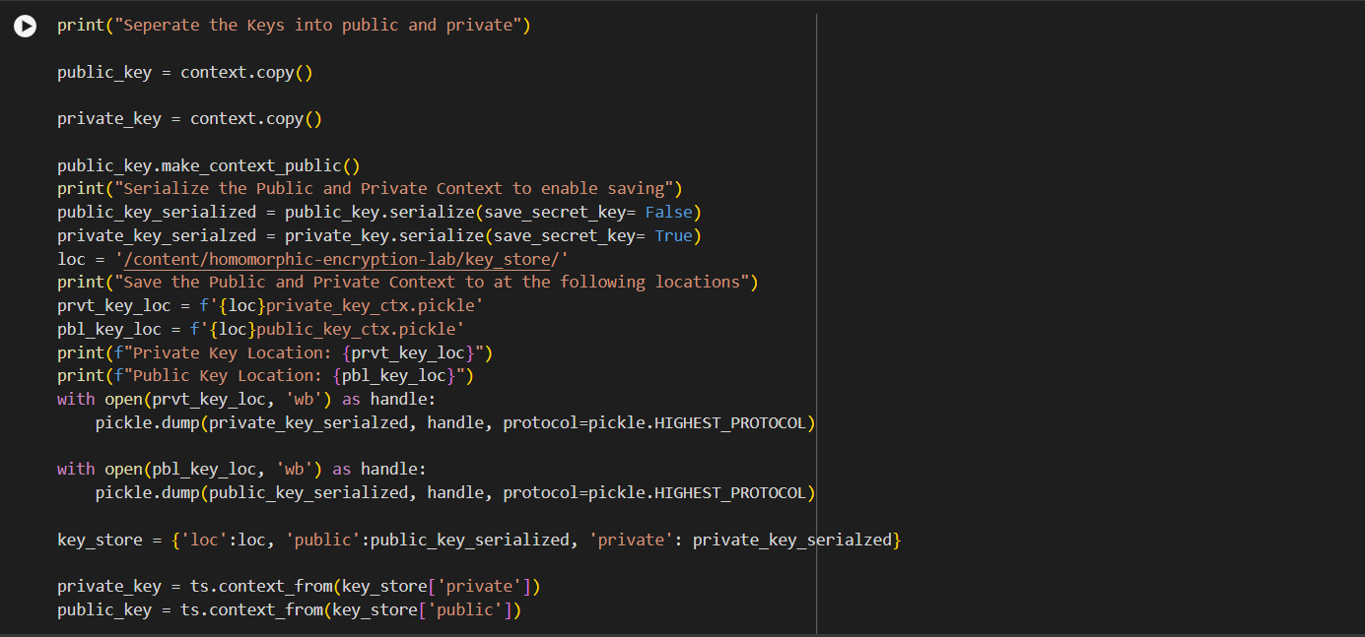

Slide 77


Slide 79


Slide 81


Slide 82


Slide 83


